Slide 1

CTEC104: Communication and Technology

Slide 2

Intercultural Communication

Slide 3
Learning objectives
After studying this chapter, you should be able to:
Explain the concept of culture, and differentiate enculturation, acculturation, ethnocentrism and cultural relativism.
Describe high-context and low-context cultural styles and discuss components of culture relevant to intercultural communication.
Explain the causes of communication barriers in intercultural communication.
Discuss the implications of comparative value dimensions for intercultural communication.
Describe the characteristics of intercultural communication competence and evaluate strategies for developing intercultural competence.

Slide 4
Introduction
Business is increasingly global and there is growing diversity within countries.
We need to know how best to:
  interact across national boundaries
  manage staff from diverse backgrounds
  communicate with a variety of customers from different backgrounds and cultures.

Slide 5
What is culture?
Culture surrounds everything we do and is so pervasive that we are rarely aware of its effects on our lives. Culture:
  is the shared views of the people belonging to that culture
  dictates rules about how to behave
  is learned behaviour that influences our attitudes and responses to other cultures
A national culture is not necessarily homogeneous.
There might be sub-cultures differing due to strong regional or religious influences, or due to immigrants mixing the two cultures they navigate daily.
An individual's personal traits are not all determined by their culture.

Slide 6
Definitions of culture
There are common threads and ideas about what culture is but there is no single definition that suits everyone's view of culture.
Hofstede (in Hofstede, Hofstede & Mlnkov 2010, p. 6) says: 'Culture consists of the unwritten rules of the social game. It is the collective programming of the mind that distinguishes the members of one group or category of people from 'another’
Hoebel and Frost (1976, p. 6) define culture as an 'integrated system of learned behaviour patterns which are characteristic of the members of a society and which are not the result of biological inheritance’.
Ferraro (2002, p. 19) defines culture as 'everything that people have, think, and do as members of their society’.

Slide 7
The process of intercultural communication
Intercultural communication occurs whenever a person from one culture sends a message to be processed by a person from different culture.
  Hall (1959) used the term intercultural communication to describe the process of communication between people of different cultures.
  Samovar and Porter (2001. p. 2) reinforce this definition, describing the process as 'the circumstance in which people from diverse cultural backgrounds are engaged in communication’.
Differences in experiences and codes and styles of communication specific to cultures affect intercultural communication and make the process very difficult.
What is important is that communication will lead to clarification and enhanced understanding.

Slide 8
Three levels of culture
The first level is visible. It encompasses the patterns and behaviour visible in the culture, including technology, buildings, artefacts and behaviour patterns.
The second level is less visible than the first level. It describes how people communicate (verbally and non-verbally ) as they explain and justify what they say and do as society or group.
The third level is almost invisible and comprises the ideas, internalised values and beliefs held by society.
Internalised values and beliefs are assumptions share by the members of a society.
  Values evolve from personal experiences and the beliefs what ideas are desirable.
  Beliefs derive from personal experience and influenced by the judgement and expertise of trusted others in the culture.

Slide 9
Three levels of culture
Through socialisation, or enculturation, we internalise the rules of interaction within our culture.
Some of these internalised rules are about:
  courtesies in speech, such as when to say 'please'. 'thank you' or 'excuse me'
  politeness—who can speak to whom and who can begin a conversation
  appropriate use of space in terms of proximity
  appropriate use of eye contact
  nonverbal behaviours and their meaning
  use of time
Internalised rules can surface in a range of intercultural contexts including business, social and interpersonal contexts.

Slide 10
Enculturation
Enculturation is a 'conscious or unconscious conditioning occurring within that process whereby the individual, as child and adult, achieves competence in a particular culture’ (Hoebel & Frost 1976, p. 58).
A member of a culture or subculture learns how to use formally and informally the patterns of cultural behaviour prescribed by that culture.
Learning about culture can be:
  unconscious (as we absorb and imitate the daily habits, speech patterns and roles of our parents from infancy) or
  deliberate (as we are taught specific manners for greeting people, religious rites and rituals and stories from the Bible, Koran, Torah or other literature).

Slide 11
Acculturation
Acculturation is the process by which people adjust to the host culture by adopting its values, symbols and behaviour.
Acculturation involves the adaptation of language, cultural beliefs and values of one group (usually the minority group) to the norms and structures of another usually the majority group).
The acculturation may involve direct social interaction or exposure to other cultures through mass media.

Slide 12
Acculturation
Adjusting in new culture is not an easy process.
Reasons for difficulties in adjusting to a new culture include:
  conflicting social norms and attempts to retain previous culture
  focusing on differences between own and the new culture
  perceiving differences as weaknesses, rather than adopting a balanced view of the new culture
Rather than abandoning their past for the new culture, people are more likely to accommodate new ideas into their own culture and try to achieve 'synergy' between the two cultures.

Slide 13
Ethnocentrism
Ethnocentrism is the use of one's own culture to interpret all other cultures.
Ethnocentric people tend to:
  use their own culture as a guide to interpret the actions, customs, values, religion, codes and behaviours of other people
  view their own culture as the 'central' culture, and use their own cultural norms as point of reference when interacting and communicate with members of different cultures
  rate all others accordingly. The greater their similarity to us, the nearer we place them; the greater the dissimilarity, the further away they are ...’ (Porter 1976, pp. 6-71).
  Awareness, knowledge and skills underpin effective intercultural communication while ignorance prevents interactions with another culture.
Ethnocentrism is a major barrier to intercultural communication and understanding.

Slide 14
Cultural relativism
Cultural relativism is the opposite to that of ethnocentrism.
Cultural relativism:
accepts that ‘each cultural group has its own set of values, behaviours and symbols and its own code of right and wrong, which are relative to that group’(Rarnburuth in Dwyer 2005, p. 36).
recognises that there are differences in the way people from different cultures perceive, receive, interpret and respond to ideas and situations
accepts that what may be considered right and valid in one culture may be frowned on in another culture
Acceptance and understanding of cultural differences as the first step to effective intercultural communication.

Slide 15
High-context and low-context cultures
Hall (1976) classified cultures on a continuum between high-context and low-context. In a high-context culture:
a large part of the message is influenced by the background and basic values of the communicator
intercultural business communication and negotiations, usually proceed slowly because the parties want to know one another
In a low-context culture:
the words in the message are explicit, and nonverbal cues have less impact on the intended meaning
members are used to move quickly to a decision
Without knowledge of the negotiating style in each culture (high or low context) members of either culture may become frustrated; tensions may arise because of a clash of styles and different interpretation of the words and nonverbal components message.

Slide 16

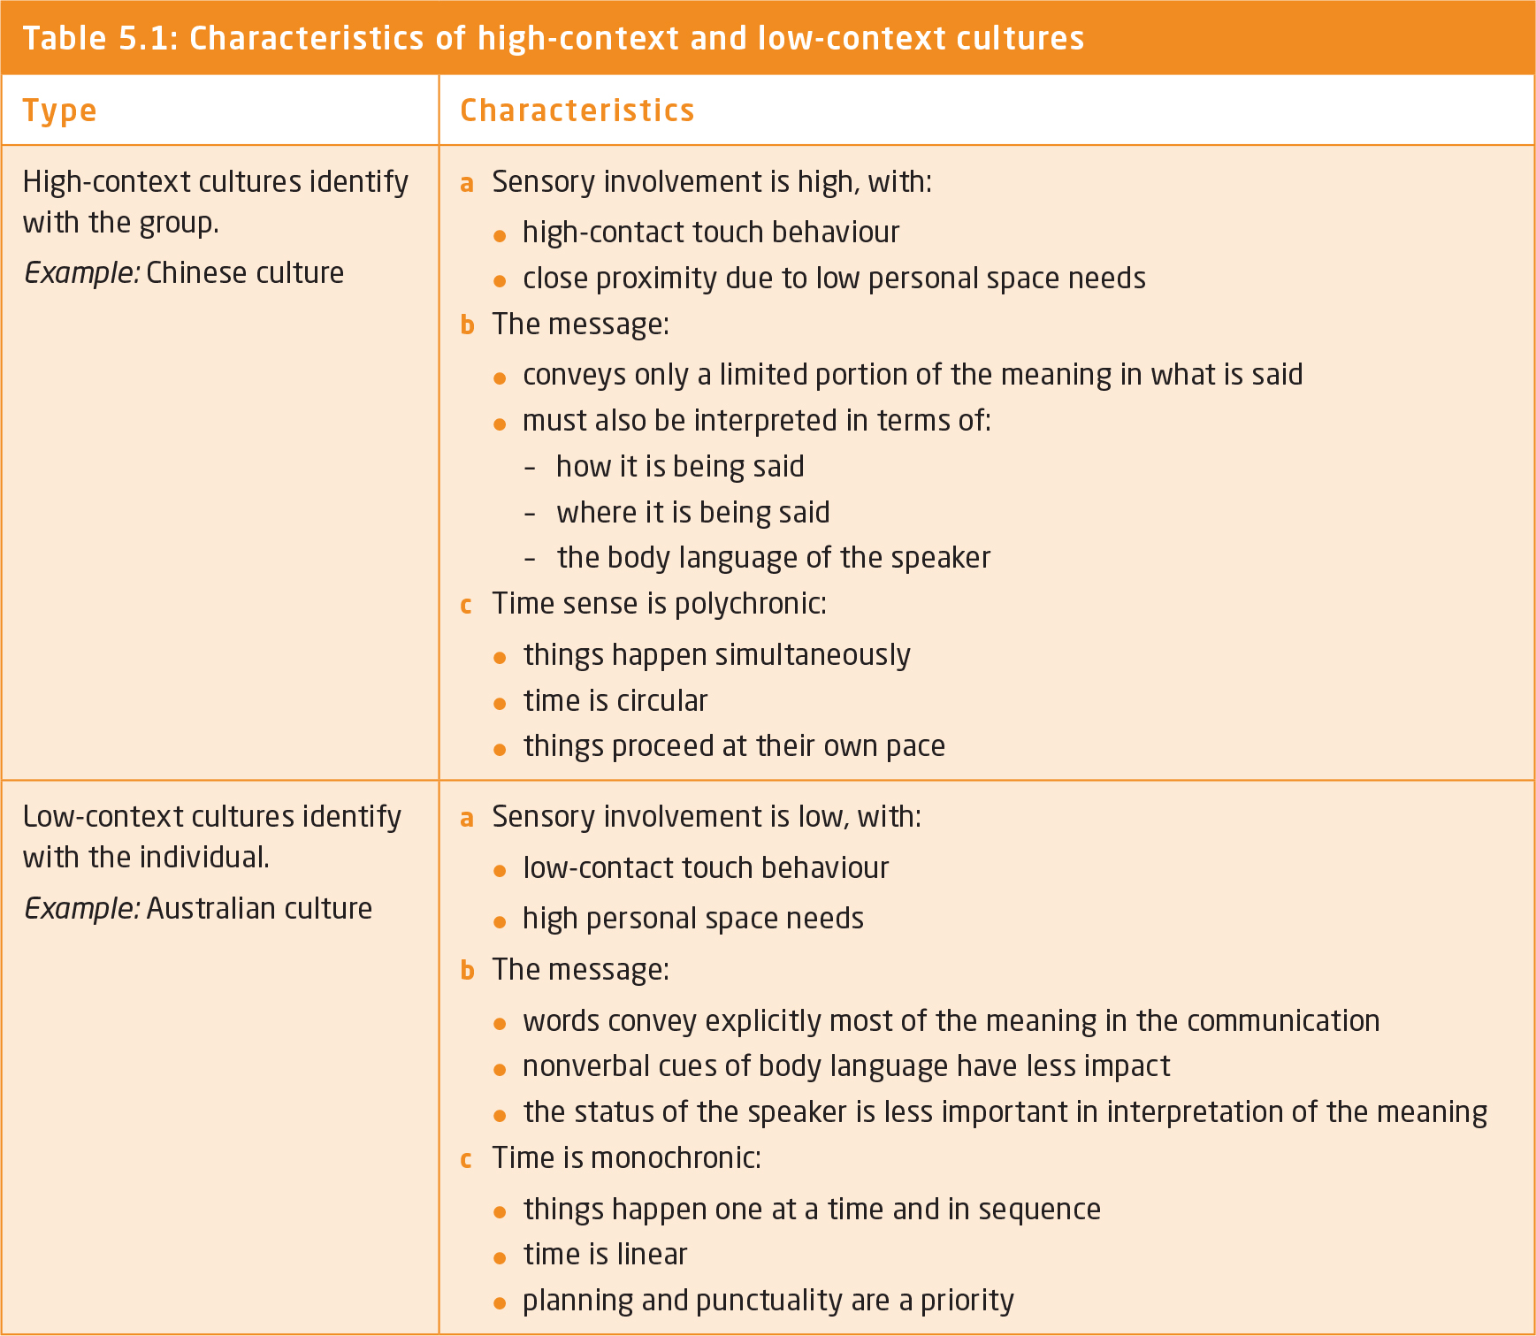
Characteristics of high-context and low-context cultures

Slide 17
High-context and low-context cultures
Tips to help boundary spanners who do business in China:
Building up good business relationships( Cquanxi) and trust is very Important so a lot of time will be spent at meetings and banquets with potential business partners.
The most senior person at the meeting will be introduced first.
A handshake is the standard way to greet men and women.
Have your card translated into Chinese on the reverse side and present your card with with both hands with the Chinese side face up. Spend a few moments examining the business card you are given as a sign of respect, rather than putting it away immediately.
Know some Mandarin—simple phrases such as ‘Ni hao' (hello).
Surnames are placed first.
Do not use your index finger or point when you are speaking.
Remain patient and polite- the Chinese people do not like to loose face. Do not loose your temper or showing frustration.

Slide 18
The relevance of cultural components to intercultural communication
Adaptation to another culture moves through three stages:
In the first stage, people take things for granted and are surprised when their expectations are proved wrong, and their approach doesn't work.
The second stage involves making sense of new patterns through communication experiences.
The third stage progresses to new understandings of another culture.

Slide 19
The relevance of cultural components to intercultural communication
In intercultural communication, patterns of cognition, verbal behaviours, nonverbal behaviours and context are important.
  Different experiences, perceptions, backgrounds, attitudes and beliefs can cause people from different cultural backgrounds to interpret the same message differently.
  Different verbal and nonverbal behaviours between cultures can cause problems in intercultural communication.
  Rules about acceptable behaviour in different contexts may lead to confusion or misunderstanding.
It is not only valuable to learn about different cultures, but it is also important to develop self-awareness, because a knowledge of self informs us about the factors that impact on our views of other people and cultures.

Slide 20
Language
Language and the meaning of words learned within a culture reflect the values of that culture values and shape its members' view of the world.
Selection of the right words can have a significant impact on the quality of intercultural communication; for example, formality and the appropriate use of titles are important in high-context cultures.
  In a high-context culture, communication may be ambiguous.
  In a low-context culture, words carry explicit meaning.
One ambiguity encountered by Australian businesspeople in Japan is whether 'yes' means 'yes' or simply: 'I hear what you are saying.’
When communicating across cultures, awareness of the meaning of words and idiomatic expressions in the language of another culture can prevent communication barriers and their consequences.

Slide 21
Nonverbal communication
Nonverbal cues can be personal, cultural or universal.
Personal nonverbal communication is person's unique behaviour pattern, and it creates a picture of the sender's personality through their gestures and mannerisms.
Cultural nonverbal communication is common to a range of people and contains clues about acceptable patterns of behavior within a particular culture.
Universal nonverbal communication has evolved as part of our biological heritage. Universal nonverbal communication behaviours such as smiling cross cultural and national boundaries.

Slide 22
Categories of nonverbal communication
Body movements- use the body language may be personal, cultural or universal.
Eye contact is more cultural than universal.
Facial expression is emotive and more universal than personal or cultural.
Paralanguage—vocal qualities such as accent, intonation, placement of phrases and tempo are more cultural than universal.
Proxemics—use of space to communicate varies between cultures.
Chronemics-use of time is more cultural than universal.
Silence conveys meaning and is more cultural than universal.
Artefacts are more personal and cultural than universal.

Slide 23
Perception of power
Power, in different intercultural settings may be perceived differently.
Two dimensions of power:
  The primary dimension, includes gender, race, age and sexual orientation.
  The second dimension, encompasses educational background, social-economic status and marital status.
In China, an older person is respected for the wisdom their age is thought to have bestowed on them.
In Australia, age may be viewed with disrespect.

Slide 24
Adapting to new cultural contexts
Intercultural encounters are characterized by high levels of uncertainty and anxiety especially when cultural variability is high.
The ability to manage anxiety and reduce uncertainty about self and others in the interaction, can enhance intercultural communication
The success of adaptation to a new culture, is influence by:
  how much the person wants to become part of the new culture
  the extent to which the person wants to interact with the new culture
Individual differences such as age, race, class, gender, personality, socioeconomic position all play a role in how a person adapts to another culture.
Even an expatriate who has lived and worked overseas for many years may need to readapt to the old culture on return to their country of origin.

Slide 25
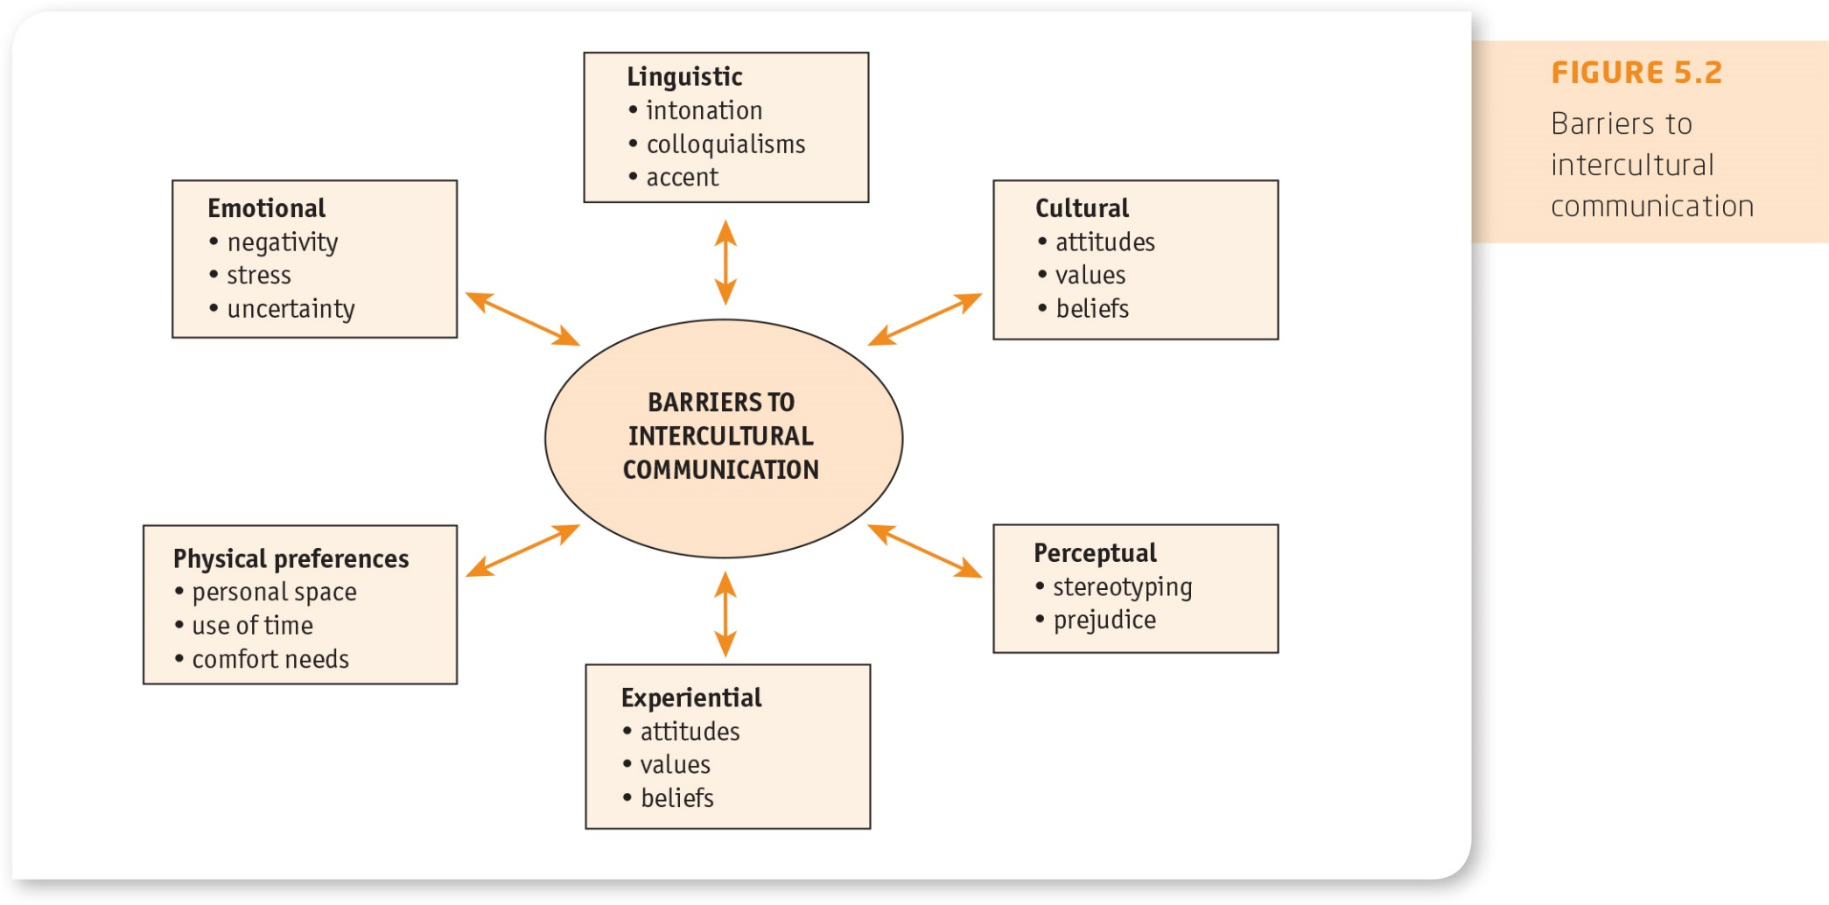
Barriers

Slide 26
Stereotypes and prejudice
Stereotyping involves accepting widely held beliefs about particular groups that are usually detrimental to intercultural understanding and communication.
Prejudice is pre-judging with little or no information and creates a negative attitude towards a cultural group.
Stereotyping or prejudice can lead to discriminatory behaviours such as avoidance, exclusion or distance from another cultural group.
Prejudice can be reduced through exposure to positive experiences and contact with those people, a group is prejudiced against.
Contact and positive experiences reduce the prejudices and enhance intercultural communication. However, the groups should:
  have roughly equal status
  share some common goals
  be in contact voluntarily
  be some support for the contact

Slide 27
Cultural practices
Cultural practices may cause confusion and misunderstanding when business interactions cross national and cultural boundaries.
In Japan, business meetings held during the day can seem to be slow to deal with key issues, whereas after-work drinks and dinners may be more useful as sources of information.
The Japanese equate being indirect with being polite. Starting a business alerting with 'small talk', will help to get the meeting off to a good start.
Australians can misunderstand this indirectness and interpret it as indecisiveness or non-commitment from the Japanese side.

Slide 28
Value systems
The value systems of a society affect the legal, political and economic practices.
One of the most sensitive and pervasive elements of culture is religion.
Perceptions of morality, immorality, habits, foods, clothing and lifestyle are all affected by religion.
Failure to appreciate a religion's significance in a specific culture can easily cause the intercultural communicator to give offence
For example, in an Islamic country, during Ramadan eating between sunrise and sunset is forbidden . Any visitor from another culture who defers to this custom by not eating in public is showing respect for the other culture without accepting the practice as their own.

Slide 29
COMPARATIVE VALUE DIMENSIONS
Many researchers have investigated the key dimensions on which national cultures differ.
Their research findings can help global business managers to improve their understanding of cultural differences and cope with workplace diversity.
Hofstede provides one of the most comprehensive frameworks for understanding cultural differences in multinational organisations.
Hofstede’s cultural dimensions:
  Power distance
  Individualism/collectivism
  Uncertainty avoidance
  Masculinity/femininity
  Long-term–Short-term orientation
  Indulgence versus Restraint

Slide 30
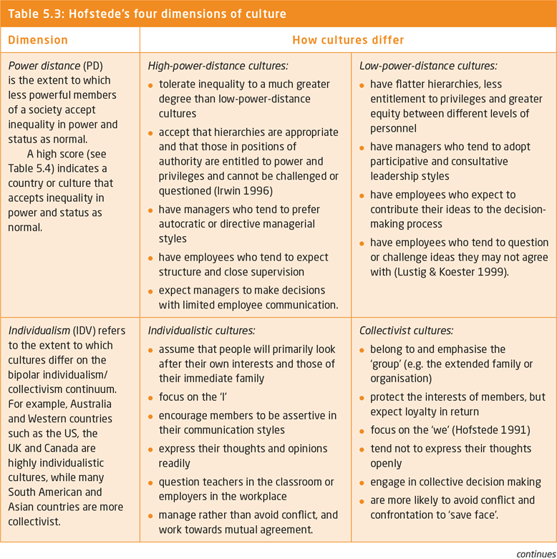
Hofstede’s four dimensions of culture

Slide 31
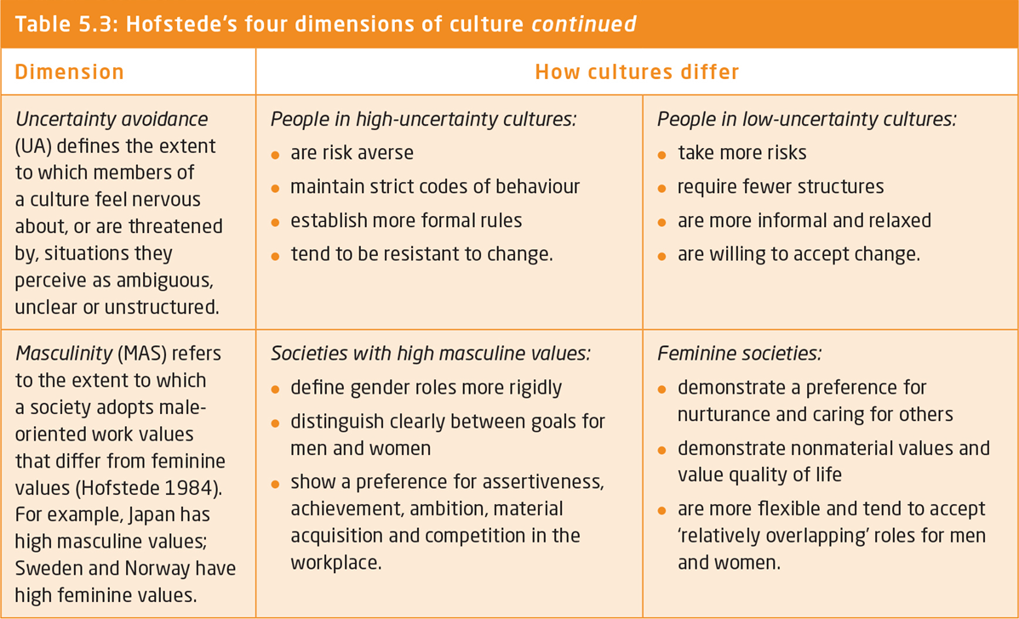

Slide 32
Hofstede’s additional dimensions of culture
Long-term–Short-term orientation: Long-term oriented societies foster pragmatic virtues oriented towards future rewards, in particular saving, persistence and adapting to changing circumstances. Short-term oriented societies foster virtues related to the past and present as national pride, respect for tradition, preservation of ‘face’ and fulfilling social obligations.'
Indulgence versus Restraint: a society allows relatively free gratification of basic and natural human drives related to enjoying life and having fun over a society that suppresses gratification of needs and regulates life by means of strict social norms.

Slide 33
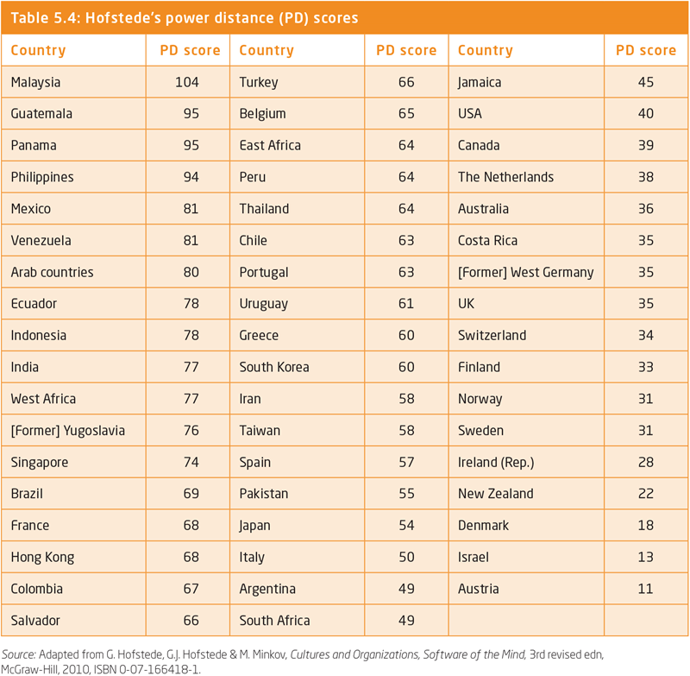
Hofstede’s power distance (PD) scores

Slide 34
Intercultural communication competence
Lack for intercultural sensitivity and the inability of negotiators to understand and function in accordance with the norms of different culture can lead to the failure of business deals and negotiations.
Mismanaging cultural differences can render otherwise successful managers and organisations ineffective and frustrated when working across cultures.
Successfully managed differences in culture can lead to:
  innovative business practices
  faster and better learning within the organisation
  and sustainable sources of competitive advantage

Slide 35
Culture-general approach to intercultural communication competence
Overcoming the barriers to intercultural communication and acquiring intercultural communication competence is no easy task.
It requires a great deal of effort and understanding of both one's own cultural norms, values and beliefs and those of people from different cultures.
Simple lists of 'do's and don'ts' or short 'quick fix' training courses for people travelling, living or working in cultures other than their own are no longer sufficient to achieve the competence required for successful intercultural interaction.
Hofslede (1991) identifies two different approaches to culture learning:
  culture-specific approaches focuses on acquiring specific knowledge about the ‘other' culture
  culture-general approaches

Slide 36
Culture-general approach to intercultural communication competence
A culture-general approach intercultural communication competence focuses on:
The development of cultural awareness and sensitivity: being aware of one's own culture but also having general knowledge and understanding about cultures,
The development of cultural and communication sensitivity: being alert to differences in communicating styles in verbal, nonverbal and interpersonal communication and in the interpretation of meanings.
The development of behavioural flexibility: moving away from cultural 'mindsets and being able to adapt to intercultural interactions as they occur.
The development of an 'other-orientation’, which requires the ability to empathise with people from cultures other than your own.
Do not assuming that it is the other person's job to communicate effectively with you.

Slide 37
Diversity and intercultural communication
Workplace diversity recognizes the value of individual differences and how to manage them in the workplace.
Diversity and greater levels of interaction across cultural and national boundaries has made intercultural communication competence and the willingness to understand and manage differences essential.
The benefits of diversity include:
  increased motivation and job satisfaction,
  retention of staff
  innovation from the broad range of ideas and insights
Managers who handle diversity successfully create environments that value the contribution of people from diverse backgrounds and develop strategies that accommodate diversity.

Slide 38
Summary
It is important to understand the concepts of enculturation, acculturation, ethnocentrism, cultural relativism, high-context and low-context cultural styles.
The components of culture include language and the meaning of words, the interpretation of nonverbal behaviours, the influence of context and the perception of power in the interaction.
Hofstede model of cultural dimensions help us to understand how communication differs across cultures.
Two approaches to intercultural competence are the culture-specific and the culture-general.

Slide 39

kent.edu.au
Kent Institute Australia Pty. Ltd.
ABN 49 003 577 302 ● CRICOS Code: 00161E ● RTO Code: 90458 ● TEQSA Provider Number: PRV12051

